Slide 1



Giving Madd Dogg Money Records
the Power to Predict Popular Music
Will Blackmon
Kene Ezeagba
Kris Skorna
Brian Willery
September 9, 2024

Slide 2
How to Compete in the Music Marketplace?
What will give Madd Dogg Money Records an advantage in the extremely competitive music sales marketspace?
Staying ahead of the industry trends
Anticipate audience preferences and tailoring promotion and content to those preferences
Identify new music communities to seek new artists
Identifying new Artists with potential for popularity and large sales volumes
Identify popular artists early in their career
Proactive promotion can maximize investments

Slide 3
Challenges of Market Prediction
How can Madd Dogg Money Records compete with larger labels with more resources?
Accurately predicting new music genre and subgenre trends
Time-consuming manual classification
Aggregating industry sales data in a timely fashion

Slide 4
The Power to Predict
Machine learning can identify patterns and relationships, which will allow Madd Dogg Money Records to classify, predict, and make decisions.
Predict the popularity of artist by analyzing historical genre sales trends
Predict future music trends through Time Series Forecasting (trends over time).
The ability to make quick decisions
Madd Dogg Money Records will be able to predict the popularity and the rise and fall of music genres over time.

Slide 5
What We Do
We obtained data for the top 3000 albums from years 1940-2019, identifying the most represented genres by year by %.
Utilizing Prophet forecasting procedure, we were visualized and analyze past trends, using those to predict future music trends with Time Series Forecasting (trends over time).

Slide 6
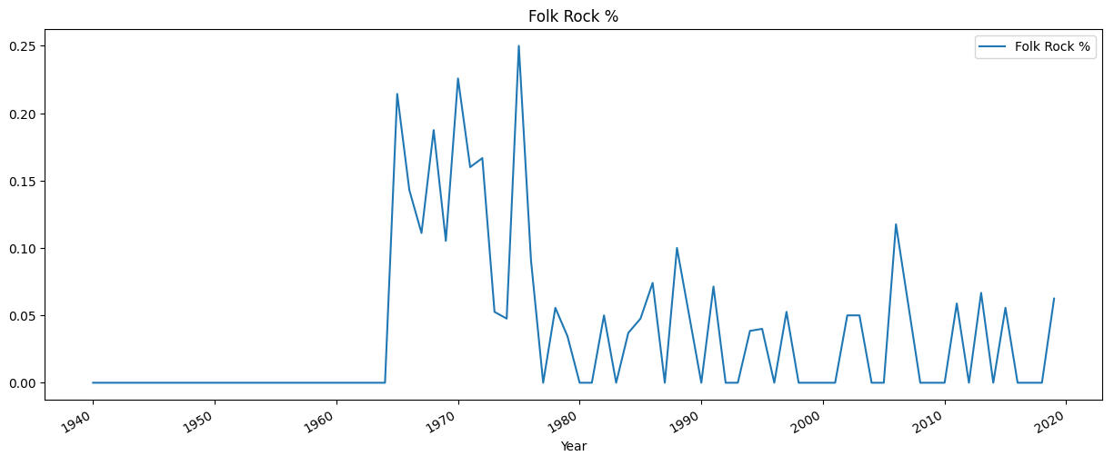
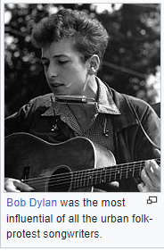
The American folk-music revival began during the 1940s; building on the interest in protest folk singers such as Woody Guthrie and Pete Seeger, it reached a peak in popularity in the mid-1960s with artists such as Bob Dylan and Joan Baez.
-source:https://en.wikipedia.org/wiki/Folk_rock#:~:text=Folk%20revival

Slide 7
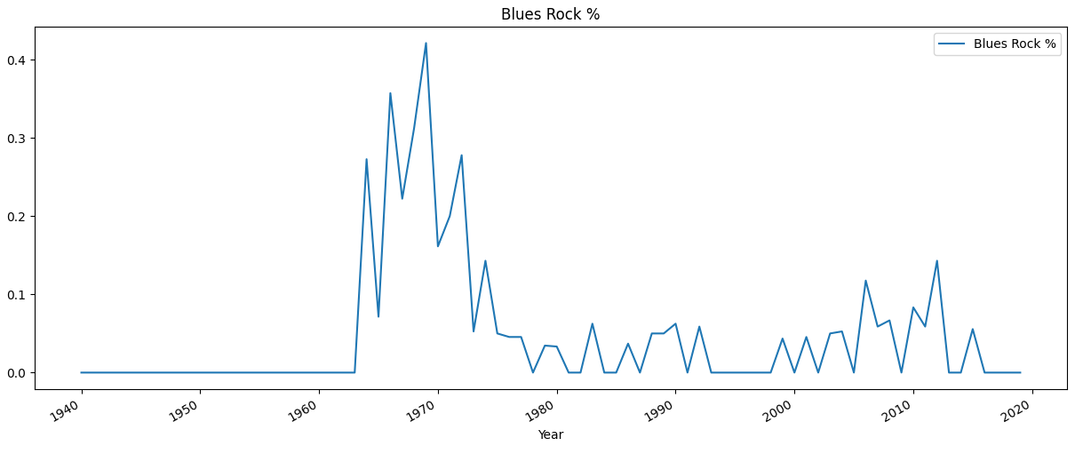
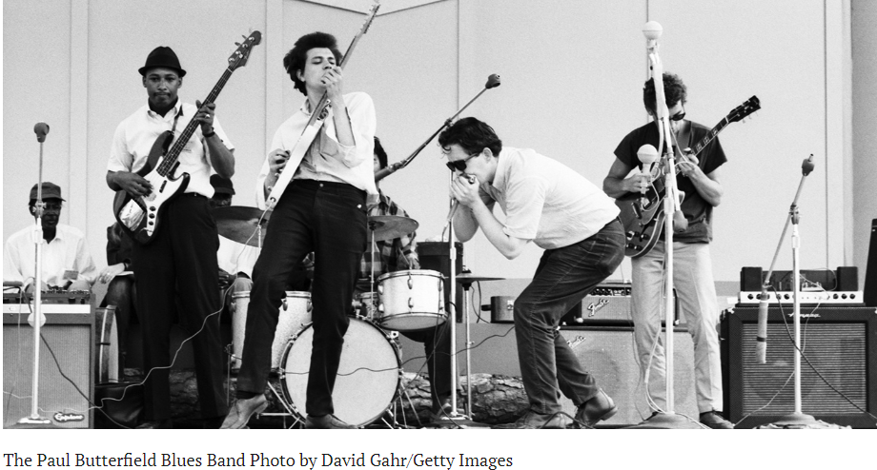
The 1960s was a transformative decade…for the blues rock genre, which saw a surge in popularity and influence.
-source https://bluesrockreview.com/2024/06/10-historic-blues-rock-performances-of-the-1960s.html

Slide 8
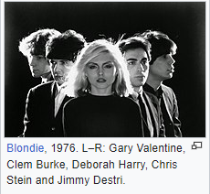
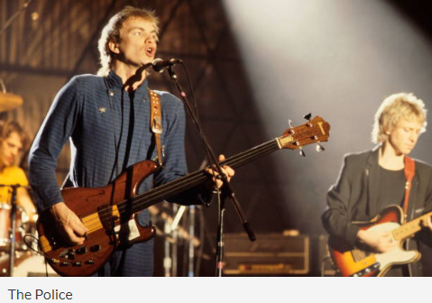
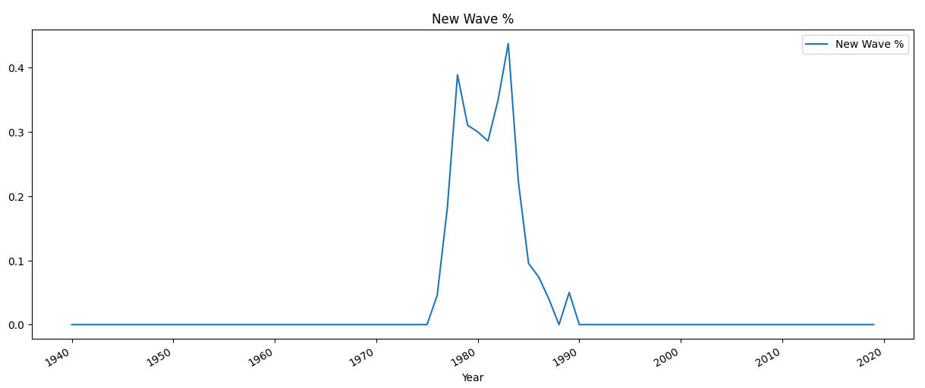
New wave commercially peaked from the late 1970s into the early 1980s with numerous major musicians and an abundance of one-hit wonders** . MTV, which was launched in 1981, heavily promoted new-wave acts, boosting the genre's popularity in the United States.
-source: https://en.wikipedia.org/wiki/New_wave_music

Slide 9
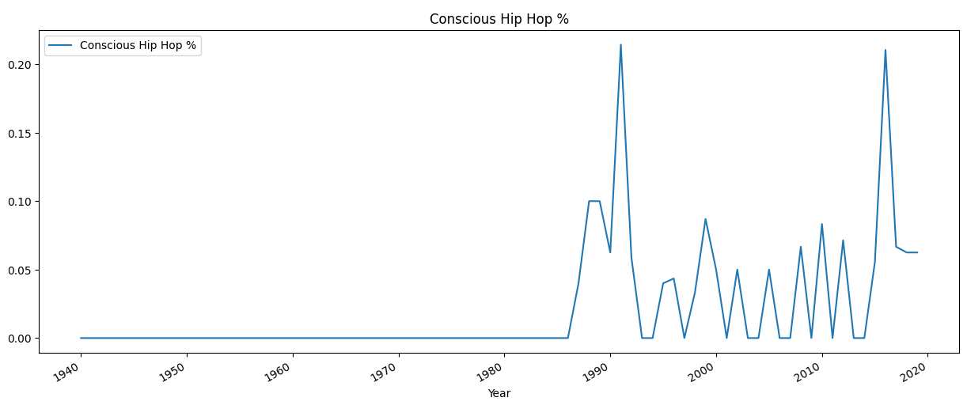
As hip-hop rose in popularity during the 1980s, conscious rap emerged from within. Six years after “The Message”, New York-based hip-hop group Public Enemy made waves with their 1988 album, It Takes A Nation Of Millions To Hold Us Back. As the 1990s continued, so did conscious rap’s prevalence.
-source: hhttps://www.soundoflife.com/blogs/mixtape/conscious-rap-origin

Slide 10
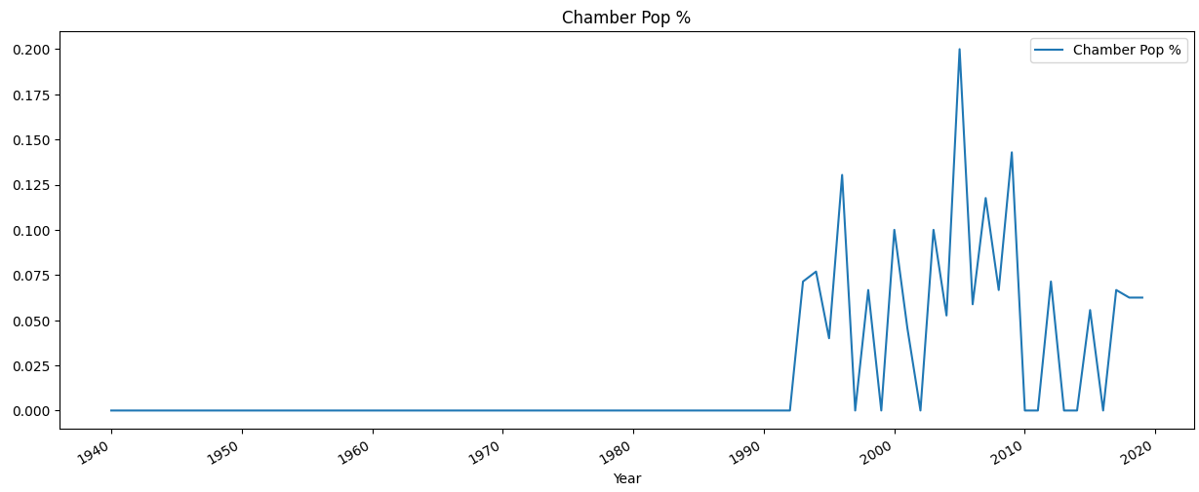
In the mid-1990s, chamber pop developed as a subgenre of indie rock^{[4]} or indie pop^{[5]} in which musicians opposed the distorted guitars, lo-fi aesthetic, and simple arrangements common to the alternative or "modern rock" groups of that era.
-source: https://en.wikipedia.org/wiki/Chamber_pop

Slide 11
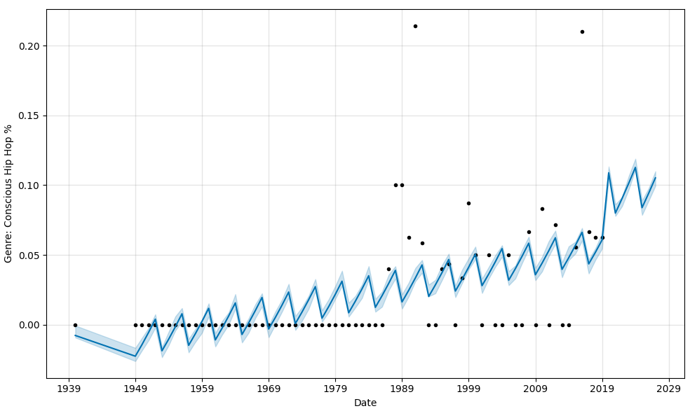
Using the Prophet forecasting procedure, the next five years suggests an increased % in records in the Conscious Hip-Hop genre.

Slide 12
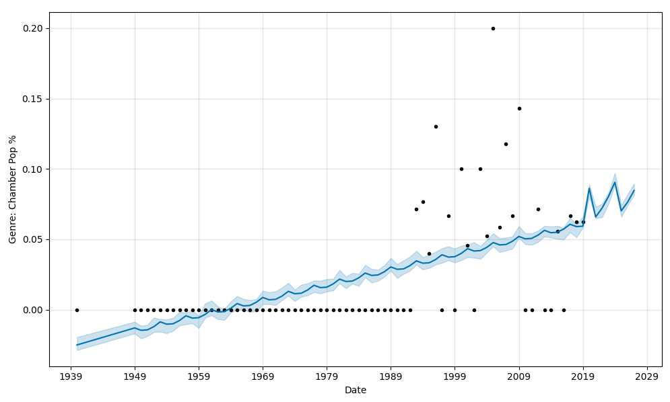
Chamber Pop

Slide 13
What does Madd Dogg Money want to be when it grows up?
What are the leading names in music?
Who are the top artist in the industry?
How will you find the next John, Paul, George and Ringo or Taylor Swift?
Will the next hottest genre be pop, New Wave, Blues Rock, Folk Rock, Chamber Pop, Conscious Hip Hop? Who Knows?
Why sign with BrainGain-Analytics?

Slide 14
Are you ready to know the future?

